Slide 1

Crowdsourcing ISP Characterization to The Network Edge
Zachary Bischof, John Otto, Mario Sánchez, John Rula,
David Choffnes*, Fabián Bustamante
Northwestern U., *U. of Washington
Notes:
Good afternoon, my name is Zachary Bischof. I am a graduate student at Northwestern University studying with Prof. Fabian Bustamante. Today I’ll be presenting Crowdsourcing ISP Characterization to the Network Edge. This work was in collaboration with the rest of AquaLab.
This work focuses the analysis of residential broadband services. We want to involve as many users as possible, without relying on SamKnows.
But first, what does ISP characterization actually entail?

Slide 2



ISP Characterization
What is it?
  Understand how various factors affect performance
Who needs it?
  Subscribers shopping for alternative ISPs
  Companies providing reliable Internet services
  Governments surveying the availability of high-speed Internet services to their citizens
ISPs ‘still mislead’ on broadband
July 26, 2011
Broadband Speeds Are Largely as Advertised
August 2, 2011
Notes:
As I’m sure you’re aware, ISP characterization requires more than just a single bandwidth benchmark. We want to identify the impact of other factors, such as congestion, management policies, service reliability, and customer location.
This way, we can accurately describe a particular service in a particular location and at a particular time.
Access to this information would be helpful for multiple groups of people. First, and perhaps foremost, is the customers themselves, shopping for ISPs. It’s also of interest to companies that provide services over the Internet, such as video streaming. When evaluating the user experience, they must take into account the quality of broadband services that are available to their target audience. And lastly, governments want to know what services citizens are using.
We’ve seen reports saying users in the UK are being misled, and that services in the US match what is advertised, but not all users would agree.

Slide 3
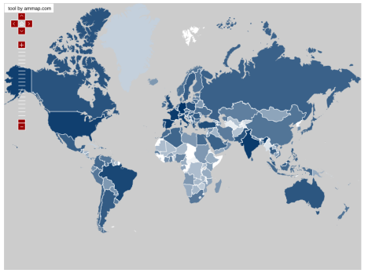

ISP characterization – how should it be done?
At scale
  To capture the diversity of providers
  and services
Continuously
  To capture dynamic changes in management
  policies, and unscheduled events, …
From end users
  To guarantee accuracy, reduce bias
Notes:
We argue that ISP characterization, done right, should fulfill the following criteria:
- First, it should be done at scale, to cover as many connections as possible and capture a diverse set of ISPs and services. Ideally, we want to characterize every connection.
- Second, it should be be able to continuously monitor individual networks. This way, we can capture network issues or service interruptions, changes in traffic management policies or diurnal trends in performance,
- And third, it should be done by end users. Not only does this mean that we include the last-mile link in our measurements, but really, who else would you trust? Probably not the ISPs themselves. This way, we can guarantee accuracy and reduce bias.
However, based on the past work we’ve seen on this topic, It’s difficult to meet all of these conditions, and as such, we are left with compromises.

Slide 4
Existing approaches to characterization
Web-based, user-initiated tests against
dedicated or cloud servers
  E.g. Netalyzr, Speedtest, …
End-host monitoring from dedicated
servers
  E.g. Dischinger et al. (IMC07) , Croce et al. (PAM09)
Installing special monitoring devices at
PoPs or home networks
  E.g. BISMark, SamKnows, Keynote
An unavoidable tradeoff among vantage points, coverage and continuous monitoring?
Scale
Continuous
End-user
Scale
Continuous
End-user
Scale
Continuous
End-user
Notes:
We’ve found that previous work on this front can be roughly classified into these three categories.
The first is web-based tests.
These have a low barrier to adoption, but they run for a very short period of time, limiting their continuity of coverage. Also, many of these test are susceptible to white-listing by ISPs.
The second method is measurement probes from the core of the network to end users.
However, this generally use unsolicited probes that saturate an end-user’s connection. Additionally, it’s not performed at the end-user’s location, so we cannot see what the user sees.
The third method is installing monitoring devices at points of presence or home networks.
Installations in PoPs, such as Keynote, do not cover the last-mile link, which significantly affects performance.
Installations in home networks, such as SamKnows and BISMark have a great vantage point to monitor performance. They’re from the end-user and can continuously monitor performance. However, while there are no technical reasons that limit their scalability, coverage is limited by the cost to deploy infrastructure in today’s large and rapidly evolving network environment. And also, SamKnows’ studies in the US and the UK required the support of government agencies.
These solutions all exhibit a seemingly unavoidable tradeoff among our previous criteria.

Slide 5
Our Approach
Crowdsourcing ISP Characterization to the Network Edge (C2E)
  Leverage the views of popular, network-intensive applications from the end-user
    (e.g. VoIP, P2P, IPTV, gaming, …)
  Reduce number of active measurements
  Based on experience of end users
  Continuous monitoring achieved by combining views of multiple subscribers
  Application usage can grow with the network edge
Scale
Continuous
End-user
Notes:
Our approach, crowdsourcing ISP characterization to the network edge, rather conveniently, matches our earlier criteria. We argue that by leveraging the views of popular, network intensive applications, such as P2P or video streaming, we can fulfill all of our criteria and provide a nearly ideal platform for ISP characterization. Additionally, piggybacking onto popular applications allows us to reduce the need for active measurements.
Its results are based on the actual performance a user experiences. By combining the views of multiple users, we can obtain continuous coverage of individual networks. Also, its low barrier to adoption means that C2E has the potential to grow with the network edge.

Slide 6
BitTorrent as a Hosting Application
BitTorrent
  Relatively long session times
  High bandwidth usage
Ono – client extension for Vuze
    Aims to improve performance by suggesting “closer” peers
    Users voluntarily contribute performance statistics
  In total, about 1.3+ million users world-wide
  Datasets from November 2009 and 2010
Notes:
Here we’ll be looking at BitTorrent as an example hosting application. Due to it’s relatively long session times and high bandwidth usage, it is an excellent candidate for C2E.
Our results that will follow are based on data collected by Ono, one of AquaLab’s BitTorrent extensions for Vuze. Ono aims to improve performance by selecting peers considered “closer” in the network.
Next I’ll follow with examples showing how C2E fits with our previous criteria.

Slide 7
At Scale
Variations within a service level among 19 Virgin Media covered UK cities (ordered by maximum)
Belfast (pop. 280k)
Crawley (pop. 100k)
Nottingham (pop. 290k)
Scale
Continuous
End-user
Notes:
First, I’ll explain why we argue that it must be performed at scale. Average consumers expect to get their advertised service, regardless of location or time. However, we found wide variations in the maximum achievable download rate for Ono users on Virgin Media’s network. This graph shows the maximum, 75th percentile and median achievable download rate during November 2009.
One user in Belfast reported some of the fastest achievable speeds. However, this was 40% faster than the median achievable rate in the same city. Users in Nottingham, in particular, showed a significant variation in attainable speeds. The median achievable transfer rate was less than 50% of the reported maximum in that city. Meanwhile, the difference in Crawley was relatively consistent compared to the others. Here we did not find any strong correlation between a performance and location or population.
Without a scalable approach, you can end up with an incomplete view of ISP performance. A solution for ISP characterization must be able to identify these differences, even within the same service level.
Users:
Belfast – 6
London – 91
Oldham – 20
Nottingham – 11
Crawley – 7
At least 5 users per city, [6, 8, 7, 91, 6, 5, 20, 7, 11, 17, 6, 13, 5, 5, 5, 7, 5, 6, 7]
Median: 7
Mean: 12.5
Std: 19
City 13 has 5 peers, Newcastle Upon Tyne

Slide 8
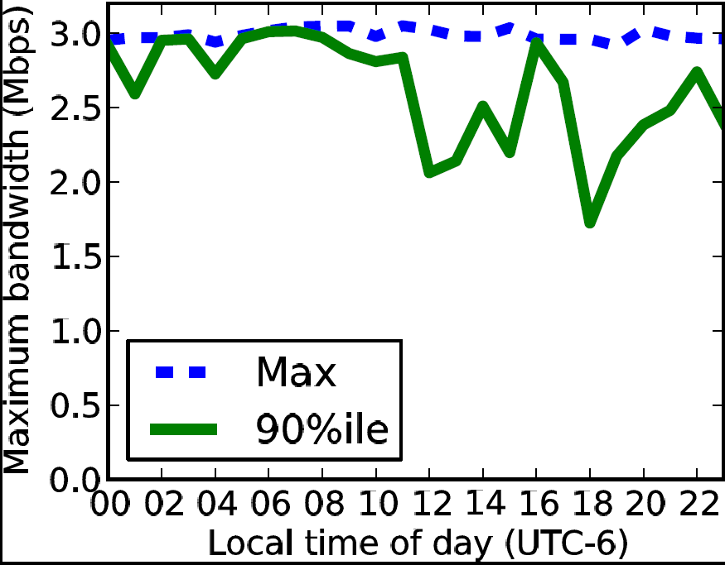
Continuous Monitoring
Variations on Rogers performance during the day (aggregated over Nov. 2009)
From 96% to 60% of advertised service level.
Scale
Scale
Continuous
End-user
Notes:
We also argue that ISP characterization should be performed continuously. This is important because the performance of a subscriber’s service can change over the course of a single day.
For example, Rogers, an ISP in Canada, was reported by Dischinger et al. to show clear diurnal patterns in download rates. Here we aggregated a month of BitTorrent data of all peers Rogers’ 3 Mbps service. The maximum achieved transfer rate for all hours of the day is fairly consistent throughout, hovering around 3 Mbps. However, the 90th percentile download rate drops from about 2.9 Mbps in the morning to as low as 1.7 Mbps during peak usage time in the evening. This is a drop from 96% to 60% of the advertised service level.

Slide 9
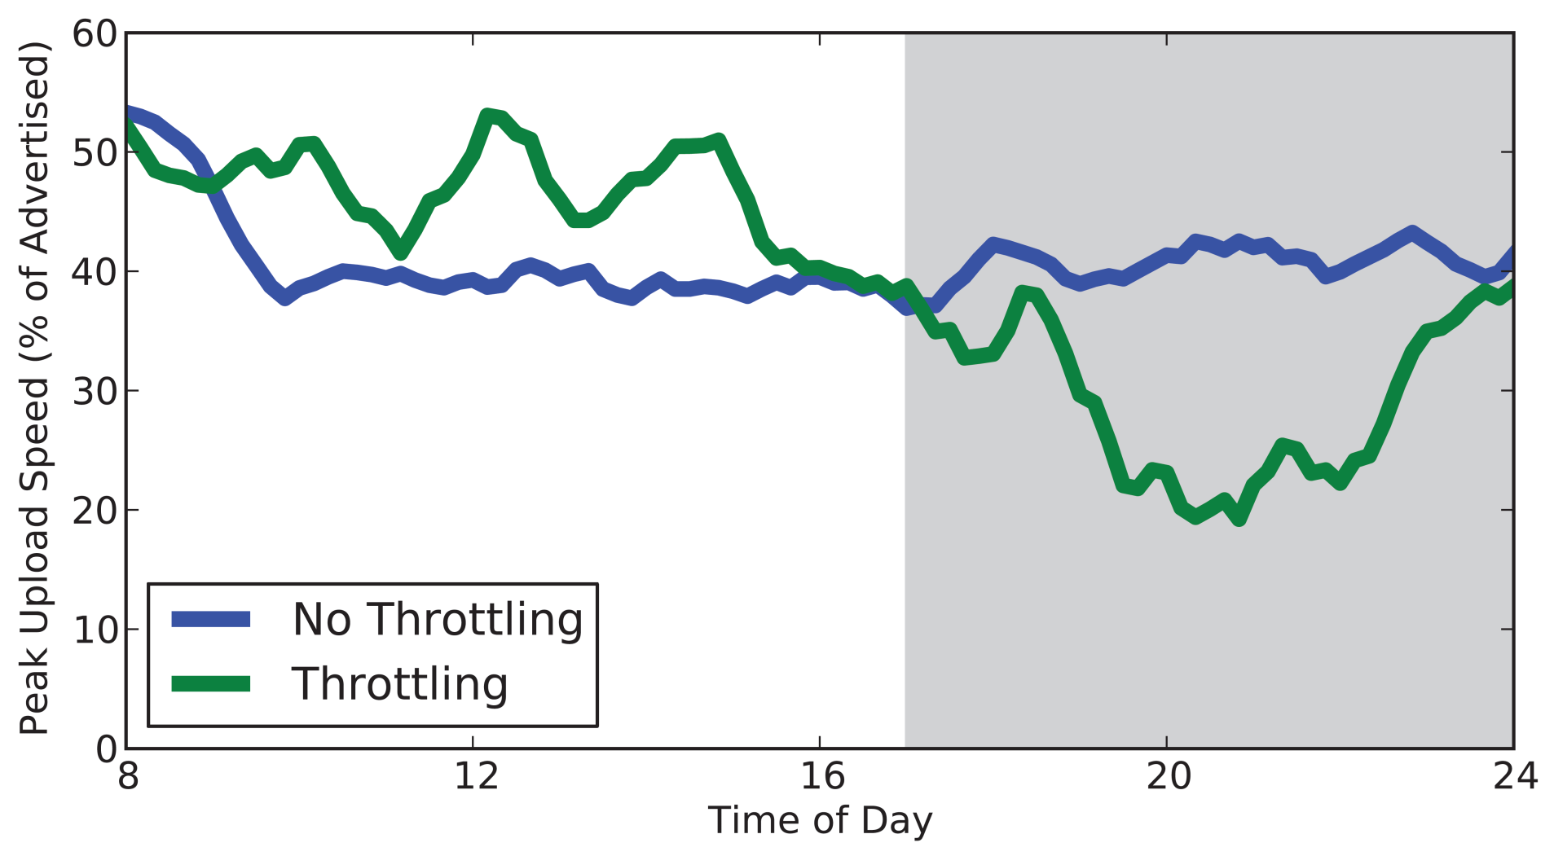
Continuous Monitoring
Virgin Media new throttling policy in effect
Upload rates drop by about 50%
Upload speed before and after new throttling policy.
Daily upload throttling period
Scale
Scale
Continuous
End-user
Notes:
In addition to daily trends in performance, we also want to capture changes in an ISP’s policy, another reason why ISP characterization must be continuous.
This past year, Virgin media began testing new service policies. More specifically, they began offering faster upload speeds. However, at the same time, they began throttling upload traffic from 5PM to midnight.
This graph shows the average daily peak upload rates the week before the throttling policy was implemented, labeled “No throttling”, and the week after the policy was implemented, labeled “Throttling”. The shaded region represents the daily period when the throttling policy was enforced. Here we see a significant drop in the average upload rate while the throttling policy is active, by about 50%
Without continuous monitoring, it is difficult to identify these daily and long term trends in performance.

Slide 10
From the End-User
Capturing the end-user’s view
Normalized number of DNS timeouts
DNS servers stop responding and clients give up!
Reported period of Comcast DNS outage
Scale
Scale
Continuous
Continuous
2010
End-user
Notes:
Lastly, we argued that ISP characterization should be performed at the end-user. In addition to the concern of biased results, we need the end-user’s perspective to fully analyze their service.
For example, consider DNS, a critical component of the internet ecosystem. Its failures are extremely visible to the end-user. Simple bandwidth measurements from the core, or even connections on BitTorrent, may see perfectly fine network conditions, despite the fact that the user is experiencing issues with their service, due to a DNS outage.
But how do you know what DNS servers to measure in each ISP? Why not just crowdsource it from the users?
In this graph, we look at multiple DNS servers failing in Comcast’s networks in November 2010. It shows the number of DNS timeouts per hour, normalized by the hourly average. The pink shaded region represents the reported period when servers were down. At about 5 pm, requests began to timeout due to a primary DNS server failure. A few hours later, a secondary server fails. Then clients began backing off, waiting for the servers to return. During this time, to these users, any task that requires a DNS lookup isn’t working. Again, having the end user’s perspective, helps us understand how users were affected by these failures.

Slide 11
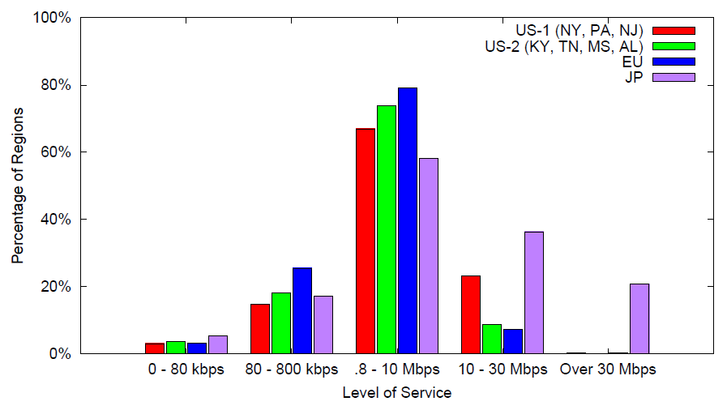
Beyond single ISP characterization
Percentage of cities containing at least one ISP providing each category of service
USA: Kentucky, Tennessee, Missouri, Alabama
Europe: Germany, Italy, France, UK
USA: New York, Pennsylvania, New Jersey
Japan
Scale
Continuous
End-user
Nov. 2009; mapped with GeoLite
Notes:
In our work, we are also exploring the applications of C2E beyond single-ISP characterization. Due to C2E’s scalability and low barrier to adoption, we are able to compare broadband services around the world without any hardware infrastructure requirements.
Here we looked at the rates of broadband availability in 2009 across four different regions around the world, two in the US, one in the European Union, and all of Japan. We classified each ISP in a city into one of 5 categories according to the fastest achievable download rate.
The first region included New York, Pennsylvania, and New Jersey. This area had the widest access to services faster than 10 Mbps in the US.
The second region, which included Kentucky, Tennessee, Missouri and Alabama, had less access to services faster than 10 Mbps and more heavily relied on services slower than than 10 Mbps services
The third region, in the European Union, included four countries, Germany, Italy, France, and the UK. Again we see wider access to services slower than 10 Mbps and less access to services faster than 10 Mbps. (We speculate that this may be due to more services relying on DSL)
We also included Japan, given its high penetration rate of fiber-based broadband access. Japan had more access to Internet services faster than 10 Mbps and was the only region to have significant access to services faster than 30 Mbps.

Slide 12

Current Status
Looking to leverage other network-intensive applications
Dasu – C2E implementation
  Inform users of ISP performance
  Eliminate confounding factors
    Cross traffic
    Wi-Fi or Ethernet?
  Complementary to SamKnows/BISMark
Notes:
We are currently looking to leverage other network-intensive applications that could support C2E.
In order to improve the descriptiveness of our analysis, we have deployed Dasu, an extension for Vuze that focuses on ISP characterization. It providers users with a description of their BitTorrent, DNS, and HTTP performance, as well as the user’s historical bandwidth usage.
Two major issues with monitoring from end-hosts include cross traffic on the home network and the impact of the home wireless connection. In order to detect cross traffic, Dasu communicates with home routers over UPnP. Also, Dasu attempts to determine if an end-user is using Wi-Fi or Ethernet by looking at their network interface configuration. This way, we know when wireless may be affecting our measurements.
We intend for Dasu, and C2E in general, to be a complementary approach to SamKnows and BISMark. For example, can we use network application performance to inform hardware deployment or identify regions in need of further analysis? Also, we plan to use the results of these works to improve our approach.

Slide 13
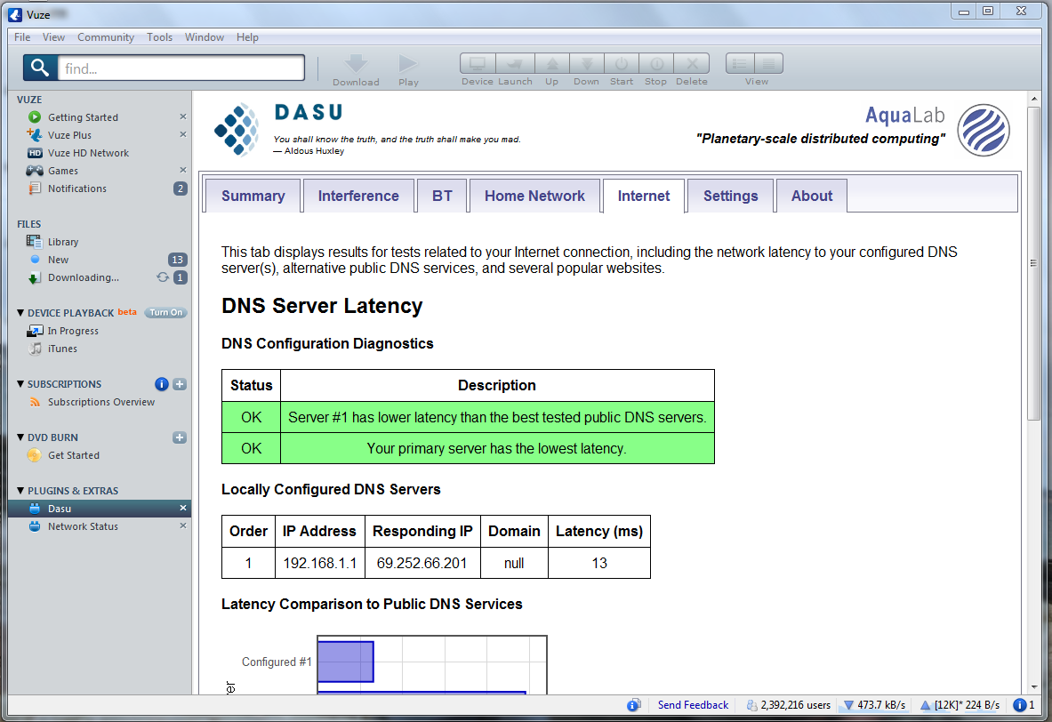
Dasu v3
Notes:
A screen shot of Dasu running, measuring DNS performance.
Thank you. I’ll take any questions you may have now.

