Slide 1

In and Out of Cuba: Characterizing Cuba's Connectivity
Zachary S. Bischof
John P. Rula
Fabián E. Bustamante
Northwestern U.
Notes:
Hi everyone, today I’ll be talking about some ongoing work which looks at Cuba’s Internet traffic, specifically, traffic into and out of the island.
This work was done in collaboration with my lab mate, John Rula and my advisor, Fabian Bustamante (who, btw, is *not* from Cuba but from Argentina)

Slide 2


A networked Cuba
Dec 2014: US announces plans to restore relations
  Easing travel and trade restrictions
  An Open Internet in Cuba a priority of the US government
Web companies are expanding into Cuba market
  Feb 2015: Netflix’s video service
  April 2015: Airbnb’s community sharing
Notes:
This work was largely motivated by recent news involving Cuba. Towards the end of last year, the US government announced plans to begin restoring relations with the Cuban government. This included the reopening of embassies in both countries as well as relaxing trade and travel restrictions. One goal of this change in policy strategy was to get more Cubans online. In fact, President Obama stated that one condition for normalizing diplomatic relations was that the Cuban government increase access to an Open Internet.
In the months following this announcement, a number of companies announced plans to expand their coverage to include Cuba. Netflix announced in February that their streaming service was now available in Cuba. Interestingly, a number of journalists questioned whether the network infrastructure in Cuba could actually support a bandwidth-intensive application like Netflix.
A few months later, in April, Airbnb announced that they would be welcoming Cubans to it’s home sharing economy.

Slide 3
Progress in getting online
May 2008: Ban on personal computers lifted
Feb 2011: Construction of ALBA-1 completed
  Landings in Ocho Rios, Jamaica; Siboney, Cuba; and La Guaira, Venezuela
Jan 2013: ALBA-1 cable (640 Gbps) activated
  Increased capacity to the island ~3,000x
Notes:
To give you some background on Internet access in Cuba, I’ll briefly highlight a few recent milestones. Until 2008, private ownership of a personal computer was illegal and required special approval from the government.
Then in February 2011, the first submarine cable to Cuba, the ALBA-1, was completed. Before that, the only Internet connection to the island was over a satellite connection. However, the ALBA-1 submarine cable didn’t appear to be activated until nearly two years later in 2013. In addition to lowering latency, the activation of this cable provided a large increase in bandwidth capacity to the island.

Slide 4


But getting online is still difficult
Access is expensive
  Internet café costs >$5/hour (avg. income <$25/month)
  Broadband subscription is 85.79% of GNI per capita [ITU 2014]
  26% use the Internet, 0.04% have a broadband connection
… and slow
  Average speed of 1.67 Mbps [Ookla NetIndex April 2015]
  Ranked 197th out of 202 countries
El paquete: Cuba’s “offline Internet”
  Movies, TV shows, articles shared via CD or USB drives
Notes:
Despite this recent progress, there are many challenges to getting online in Cuba. Access in the country is expensive. Internet café’s can cost more than $5 per hour, which is over one fifth of the average monthly income. Getting a broadband connection at home is even more expensive, costing almost as much as the Gross National Income per capita. As a result, only about a quarter of the population use the Internet in some way and although about 5% of the population has a fixed line connection, most are dial up. Only a small fraction of a percent have a broadband connection.
Access is also slow. With an average speed of 1.67 Mbps, Cuba ranked towards the very bottom of Ookla’s NetIndex rankings.
Because of these barriers to Internet access, a number of “offline Internets” have appeared, where people sell or share CDs and USB drives containing movies, tv shows, articles, or software.

Slide 5
Characterizing Cuba’s Internet
To understand hindrances to getting Cuba online
Challenges
  Low rates of broadband subscription and Internet usage limit ability to measure Cuba’s last-mile links
  Little to no measurement infrastructure
This study
  Network connectivity on the island and in/out of Cuba
Notes:
Our goal with this ongoing project is to better understand the hindrances to connecting Cubans to the global Internet, both in terms of access and performance.
However, there are many challenges to achieving this goal. The biggest challenge is that the low rates of broadband subscription and Internet usage limit our ability to capture Cuba’s last-mile links. A number of studies, such as the OpenNet Initiative, are unable to publish reports on Cuba because of a lack of data. Additionally, there is very little measurement infrastructure on the island. As a result, our analysis heavily relied on probes located outside the country.
While our long term goal is to better understand both the last mile and the island’s connections to the rest of the Internet, this work focuses on measuring the latter because of our limited visibility into the country’s edge networks.

Slide 6
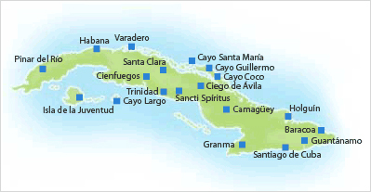


Cuba’s Internet
AS222351
Intelsat
AS27725
ETECSA
AS11960
CubaData (IXP)
AS27725
NewCom
AS10569
Red CENIAI
AS12956
Telefonica
AS6453
Tata
Notes:
This map shows the networks that operate throughout Cuba. ETECSA (27725) is the primary access network on the island and hosted many government websites. Red CENIAI (AS10569) is a small academic network. AS11960 is a government-operated IXP, all traffic in and out of Cuba travels through this network. We found four different networks that were commonly used to reach the island. Telefonica and Tata leveraged the recently constructed submarine cable, while Intelsat and NewCom reached the island via satellite.

Slide 7


Datasets
Two months of data (March, April 2015)
RIPE Atlas probes
  ~50 probes across North and South America
    25 in US, Mexico, Venezuela, and Brazil
    25 spread throughout the Caribbean – One probe in Cuba
  Measurements
    Traceroutes to other vantage points and popular sites
    DNS queries (local and public)
    SSL certificate requests to popular websites
Namehelp from Northwestern
  ~6,000 clients in ~600 networks
  Traceroutes to prefixes in Cuba
Notes:
I’ll briefly describe the measurement sources that we used in this paper. All of our measurements were collected over a two month period during March and April of this year.
We selected 50 RIPE Atlas probes located throughout North and South America. Half were in the US, Mexico, Venezuela, and Brazil. The other half were spread throughout the Caribbean, including a single probe located in Havana Cuba.
From these probes we ran traceroutes, DNS queries, and SSL certificate requests. We discuss the other measurements in the paper, but in this talk I’ll be focusing on our analysis of traceroute data.
We also launched traceroutes to prefixes in Cuba from Namehelp, a tool published by our lab back in 2012. This dataset had approximately 6,000 clients located in 600 different networks.

Slide 8
High RTT for traffic to/from Cuba
Latency from Cuba is ~240 ms higher!
Notes:
One of the first things we did was compare latency performance in Cuba to other islands in the area. This figure shows the distribution of ping measurements from Atlas probes in the Dominican Republic, Puerto Rico, and Cuba to one of our machines in Chicago.
What we found was that latency measurements from Cuba were often over 240 ms higher than measurements from other islands in the area.

Slide 9
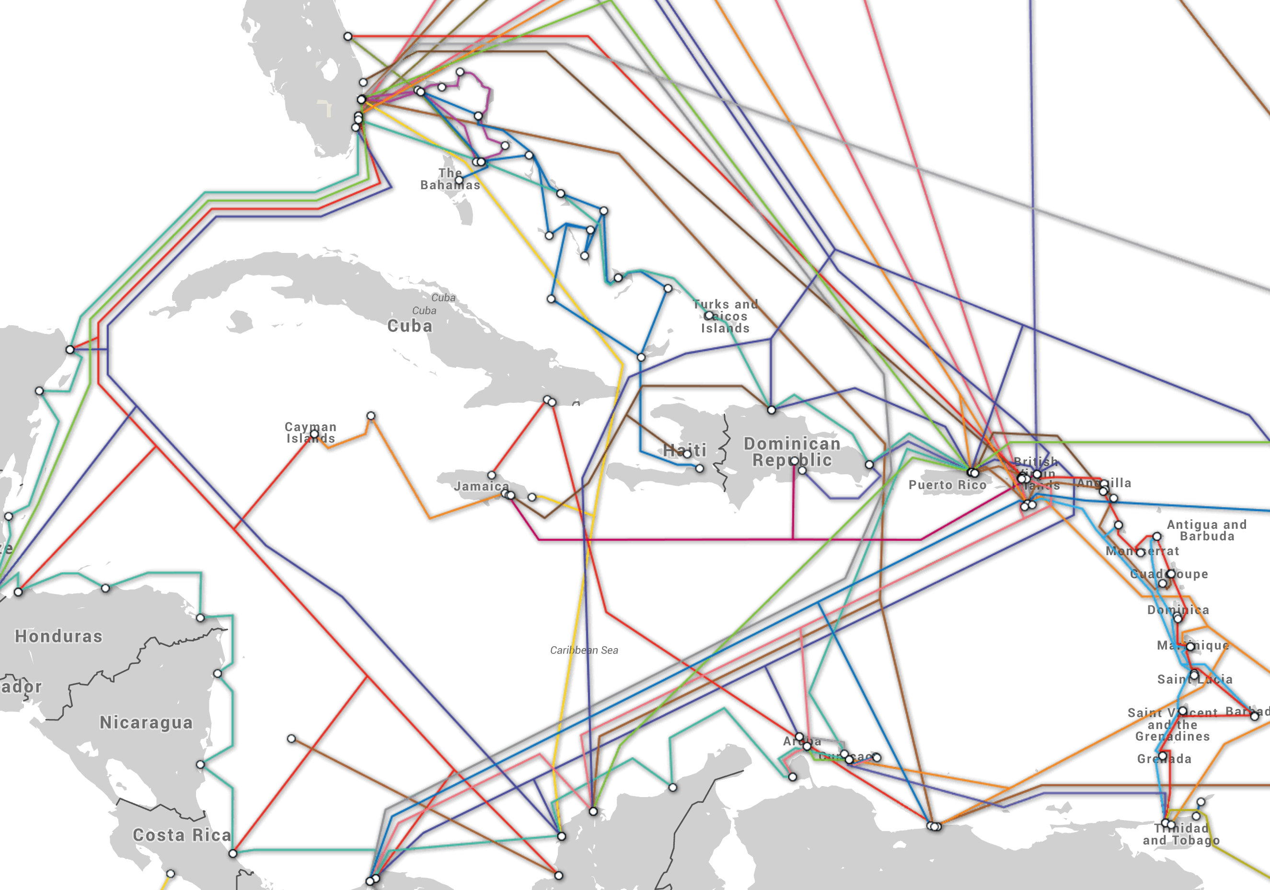
Cuba’s connectivity
ALBA-1
Source: submarinecablemap.com
Notes:
This map shows the submarine cables in the Caribbean. Despite the large number of cables in the area, only one, the ALBA-1 lands in Cuba. Some even detour around the island.
When we looked at traceroute measurements from the probe in Cuba, we saw that all paths traffic out of the island traversed this submarine cable. However, we did see large increases in latency soon after traceroute probes reached the US.

Slide 10

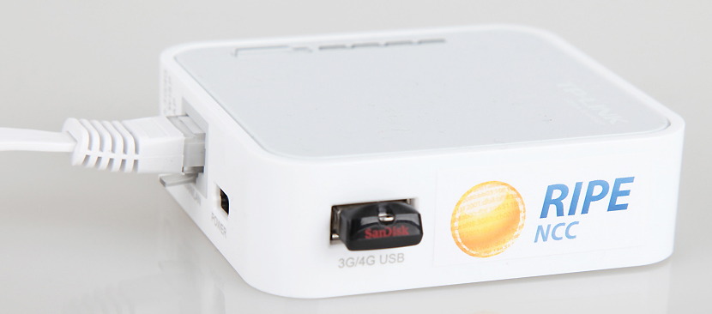
Example: to & from Miami
Takes 240 ms!
RTT jumps to 350 ms!
75 ms
120 ms
Telefonica (Venezuela)
Telefonica
(US)
Havana
probe
Miami
probe
Notes:
In order to diagnose the cause of this increase, we measured the forward and reverse paths between Atlas probes in Havana and Miami. We found that reaching the egress of the Cuban IXP was very quick, taking only a couple milliseconds. RTT increased to about 75 ms after traversing the ALBA-1 cable. Then to about 120 ms once it reached the US. However, once the TTL had become high enough to reach the network of Atlas probe in Miami, RTT jumped from 120 ms to 350 ms.
After examining the reverse path traceroute, we realized that this caused by response traveling to Cuba via a high-latency satellite link, which takes approximately 240 ms.

Slide 11
Transit network and performance
Ran traceroute in both directions
  Namehelp users ➔ Atlas probe in Cuba
  Atlas probe ➔ Namehelp users
All routes out of Cuba via Tata or Telefonica (ALBA-1)
Routes into Cuba split between satellite and submarine cable
Transit network to Cuba largely determines RTT
Notes:
To look at how wide spread this issue was, we ran traceroute in both directions between the Atlas probe in Cuba and our Namehelp vantage points around the globe. We found that all routes out of Cuba traveled through either Tata’s or Telefonica’s networks. However, routes into Cuba were split between satellite links and the submarine cable, with the majority being routed via satellite. Because of the high latency of satellite links, the transit network used to reach Cuba was a large factor in determining RTT.

Slide 12
Comparing transit networks
y = 0.0158 x + 196
y = 0.0155 x + 372
Tata
(AS6453)
Intelsat
(AS22351)
Notes:
Next, we split paths into groups according to the transit network that was used to reach Cuba. For this first figure, we selected all traceroutes that were routed to Cuba via Tata’s network. We then selected the median end-to-end round trip time, represented by the y-axis. The x-axis represents the estimated distance between the vantage point and the probe in Cuba. The gray dotted line is provided for reference and shows the estimated time it takes, using c/2, for light to travel that distance through a cable. The green dashed line represents the linear regression of the distribution of measurements.
This next figure shows the same but for measurements that reached the island via Intelsat’s network.
Comparing the linear regression equations for these two, we see that the slope is very similar.
However, the y-intercept is about 180 ms higher as a result of traversing the high-latency satellite link.

Slide 13
RTT by country
Routed via Telefonica’s transit network
Routed via AT&T, Level 3, or Tinet to satellite network
Notes:
We noticed a few interesting trends in this dataset. For example, users in Spain and most of France were routed to Cuba via Telefonica’s transit network. While users in the US, UK, and Venezuela would be routed to AT&T’s, Level 3’s, or Tinet’s transit networks, and then be sent to Cuba via one of the satellite networks.

Slide 14
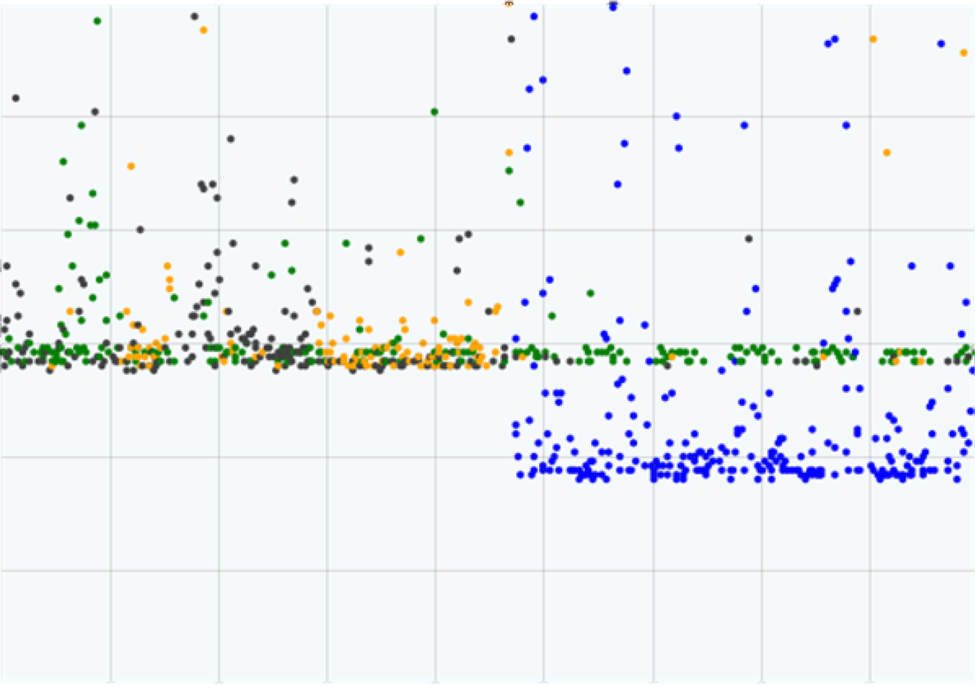
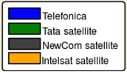
Issue dates back to 2013
From Dallas-TX, US to Cuba
10 Jan 2013 UTC to 19 Jan 2013 UTC
1200
100
800
600
400
200
0
Roundtrip Latency (ms)
Activation of ALBA-1 cable
Regression equation for x = dist(Dallas, Havana)
10 Jan 11 Jan 12 Jan 13 Jan 14 Jan 15 Jan 16 Jan 17 Jan 18 Jan
Source: http://research.dyn.com/2013/01/cuban-mystery-cable-activated/
Notes:
We suspect that this performance issue is not recent and actually dates back to the activation of the ALBA-1 cable. This figure, from an article published on the Renesys blog back in early 2013, shows that latency measurements from Dallas, Texas to Cuba decreased from about 600 ms to about 400 ms once the cable was activated. However, it appears that traffic still traversed a satellite link in one direction. Solving the regression equation for one of the satellite providers using the distance between Dallas and Havana, we get a very similar round trip time, represented here by the black dotted line.

Slide 15
Current status
Continue monitoring connectivity
  Today, more routes are using ALBA-1, but not all
Initiating conversations with scientists on the island
Cuba and beyond
  How to increase visibility into developing countries?
  Issues in developing countries are heterogeneous
    [Zheleva ’13] Zambia – Limited bandwidth to village
    [Zaki ‘14] Ghana – Far away DNS servers and no caching infrastructure
    Routing configuration issues increasing RTT by ~200ms
Notes:
We plan to extend this work and will continue monitoring Cuba’s connectivity. We are also reaching out to scientists and network operators on the island.
This work highlights a few interesting challenges. Perhaps one of the most challenging is increasing the measurement infrastructure in these networks.
Furthermore, the issues that are occurring are diverse. In recent years, we’ve seen a papers examining networking issues in developing countries. In rural Zambia, the link to the village became increasingly congested as users moved to more bandwidth-intensive applications. In Ghana, the lack of nearby DNS servers and caching infrastructure resulted in poor performance. And now in Cuba, routing policies have a significant impact on round trip times. The diversity of these issues highlights the importance of a comprehensive view of the network, from both the inside and the outside. For example, diagnosing this issue required vantage points both in and outside of Cuba.

Slide 16

In and Out of Cuba: Characterizing Cuba's Connectivity
Zachary S. Bischof
John P. Rula
Fabian E. Bustamante
Northwestern U.
Notes:
Thank you for your attention. I am happy to take any questions.

Slide 17
Availability of network services in Cuba
4,434 domains supporting HTTPS in Alexa’s top 10k most popular sites
Attempted to fetch SSL certificates for each site
Mark a site as “unavailable” if fetch failed across all 5 attempts

Slide 18
Availability of network services
111 sites were marked as unavailable
  28.9% adult content
    E.g., xhamster.com
  17.1% finance
    E.g., paypal.com, citi.com
  15.3% computer retailers and network services
    E.g., dell.com, tinyurl.com
  11.7% advertising
    E.g., adcash.com
Some sites also unavailable in other US-sanctioned countries, such as Sudan

Slide 19
Example: to & from Miami, Florida
RTT jumps to 350 ms!
Adds 240 ms!
Telefonica
75 ms
Telefonica
120 ms
Cuba
probe
Miami
probe
Venezuela
US

