Slide 1
The utility argument
Making a case for broadband SLAs
Zachary S. Bischof*
Fabián E. Bustamante*
Rade Stanojevic°
*Northwestern University,
°Qatar Computing Research Institute
Notes:
Hi everyone, today I’ll be discussing some ongoing work with my advisor, Fabian Bustamante, and Rade Stanojevic that looks at broadband SLAs.

Slide 2
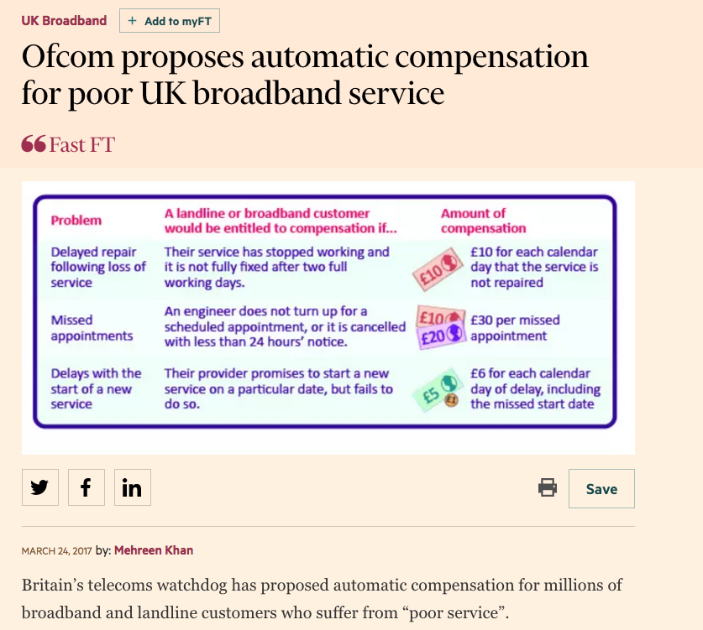

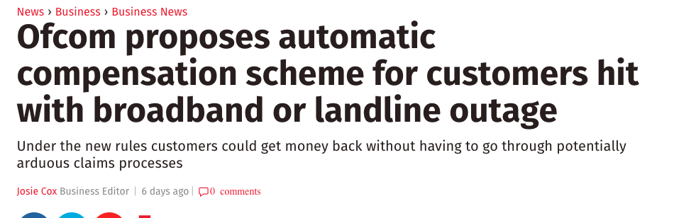
March 24, 2017
Notes:
This is a topic that we’ve been discussing for a few years now, so it was interesting to see that just last week Ofcom, the Office of Communications in the UK, published a report that they were proposing automatic compensation models for broadband users hit by service outages or extended periods of poor quality of service. For example, they propose reimbursing subscribers 10 pounds per day after two days of service issues not being fixed.

Slide 3
The importance of broadband
Nearly 1 billion fixed-line broadband subscriptions worldwide
  Consistent share of total Internet usage, despite increase in mobile subscriptions [ITU State of Broadband report 2016]
Speeds are increasing rapidly
Average connection speed
[Akamai’s State of Internet Report]
Notes:
Over the last decade, the number of broadband subscriptions has increased rapidly. Today there are nearly 1 billion fixed-line subscriptions world wide. While this growth has slowed down in recent years, the amount of traffic over these connections has been rapidly increasing.
Part of this is likely due to increases in broadband access speeds. Subscribers in countries that are investing heavily in broadband access infrastructure have seen speeds increase by 15-20% year to year.
Nearly 1 billion fixed line connections (884 million).
“while IHS/Infonetics Research estimated that fixed broadband will reach 1 billion worldwide in 2019”
“Growth in fixed broadband subscriptions roughly matches growth in overall Internet usage, with fixed broadband continuing to maintain its overall share in Internet usage over the last four years, despite the explosion of mobile broadband.”
“The speed and capacity of passive optical networks contiue to increase steadily, helping promote quality of experience (QoE) in new services and applications”
Instrumental for social and economic development
Evidence that increasing capacity can increase GDP
Declared a basic human right in several countries
E.g. France, Finland, Spain, Greece
Over the past decade, broadband networks have become one of the fastest growing sectors of the Internet. Studies have shown that increased access to broadband can result in social and economic gains, such as an increase in GDP. In some countries, as well as the UN, have declared broadband access a basic human right, similar to access to education or water, and many governments have taken steps to increase access to broadband services.

Slide 4







Broadband and greater expectations
With higher capacities, a migration to “over-the-top” services
And higher expectations of the service functioning properly
Notes:
Another reason for the rapid growth in broadband traffic is due to a large-scale migration to “over-the-top” services. Consumers are switching their cable TV and telephone services like Netflix and Vonage. There has also been an adoption of new “smart home” services, like Nest. Home security services, such as ADT, now support operation over an Internet connection for customers that no longer have a landline telephone.
However, because of the traditionally high reliability of phone and even cable, users often have higher expectations of their service functioning properly.

Slide 5
The need for (more comprehensive) SLAs
Today services are advertised based on maximum download throughput
  “Up to X Mbps”
But … empirical analysis shows there’s more that matters to users than capacity [IMC14]
  High service capacity with high latency, high packet loss results in lower usage
Disruption of service and poor service quality are most common complaints (71%)*
Z. Bischof, et. al. “Need, Want, Can Afford.” IMC 2014.
*Ofcom, UK broadband customer survey, 2014
Notes:
This has resulted in a gap between the expectations of subscribers and what providers are promising. Today, many services are defined in vague terms, such as “Up to X Mbps”. Technically, any speed below this threshold meets this definition. And users are not going to complain if it is faster than advertised. Rarely is anything about the service besides capacity mentioned.
But other works have shown that there’s more that matters to users than capacity. In a previous work, we found that, when controlling for service capacity, connections with high latency or high packet loss would negatively affect user demand.
Furthermore, in customer surveys performed by Ofcom, the most common complaints back in 2009/2010 have changed from “lack of faster options” to disruption of service and poor service quality.
Among broadband customers with reasons to complain, the two reasons that were stated most frequently by participants where disruption of service (39%) and poor quality of service (33%)
Can you not show this? Maybe from an old workshop paper or a similar setting showing the “enough” bandwidth w/ high latency won’t do it or low latency with high packet loss or high bandwidth with both high latency and loss … somehow show that all matters to the same or different applications; you can also use quotes from the same papers we use for the SLA settings
I would start the way around – you need a comprehensive SLA, but this is what you are getting
Need, Want, Can Afford: High latency, high loss connections with high throughput resulted in lower utilization.

Slide 6
Everyone could benefit from SLAs
Providers can differentiate between service offerings
  Compare a 10 Mbps fiber service vs a 10 Mbps satellite service
Users can request compensation for poor quality of service
  Ofcom in the UK has just published a proposal on this topic*
Policy makers can better gauge existing infrastructure and justify investment
* Ofcom. “Automatic Compensation.” March 24, 2017.
Notes:
These issues highlight the need for clearer agreements between providers and subscribers. We believe that this could actually benefit most parties. Porviders could differentiate their offerings from competitors. For example, using a fiber and satellite service advertised with the same capacity will result in a very different user experience, due to differences in loss and latency.
For users, it could give them a means to request compensation for poor service. As I mentioned earlier, this is something that Ofcom proposed just last week.
And for policy makers, it’d help to accurate gauge infrastructure and plan future investments.
Alternative for the question: “What kind of SLA could providers today reasonable advertise?”

Slide 7
Open issues
What should broadband SLAs look like?
  QoS or QoE-proxy metrics, and which metrics?
  One class of users or multiple ones?
  Compensation models
  Could SLA be personalized?
  …
Could ISPs provide a meaningful SLA today?
  What data can we use to understand this?
  How should we set thresholds for SLAs?
  How to account for different technologies and costs?
  …
Notes:
There are a number of open issues that we highlight in this work. For example, row the SLA should be crafted, what metrics to use, compensation models, or predicting risk. Also, is this something ISPs could actually do? What would be meaningful thresholds?

Slide 8
This work
Model SLAs after what providers offer to businesses
We define SLAs based on the needs of groups of clients
We show that even this simple model:
  Appears to be sufficient to differentiate across tech and providers
  Could be readily adopted by ISPs (in the US) without significant cost
Notes:
In this work, we model our SLAs on the business offerings of these providers. For example, Comcast has a “Business class” service with a compensation model for outages. Others guarantee certain capacity, loss, and latency rates.
As I’ll explain in a few slides, we define out SLAs based on different application needs, so a plan could depend on the user. We show that we can use these SLAs do differentiate between technologies. We find that many providers do a good job of meeting some of these SLAs.

Slide 9


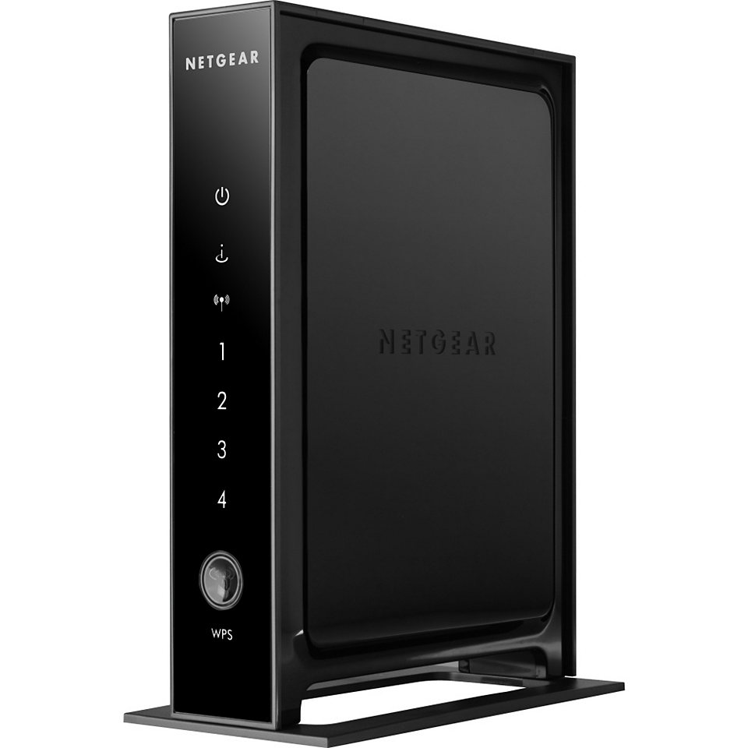
Dataset – FCC/SamKnows
Residential gateways distributed to broadband customers in the US
  Data made publicly available by the FCC
  Approximately 8,000 vantage points
Runs hourly measurements
  Capacity, latency, and packet loss
  Latency and loss measurements in per hour-long bins
Notes:
To evaluate the performance of service providers, we use data collected by SamKnows and the FCC in the US. As part of their Measuring Broadband America initiative, the FCC and SamKnows distributed residential gateways to broadband customers. These gateways conduct a number of measurements, including capacity measurements each hour and continuous latency and loss measurements that are aggregated into hour bins. In total, we use data from approximately 8,000 gateways.

Slide 10
Crafting broadband SLAs
Broadband subscribers and their requirements are diverse
  Different SLAs for different categories of use
    E.g., Gaming, video streaming, email, etc.
SLAs based on application needs
  A: Real time gaming, (ultra) HD streaming
  B: Basic video streaming, video/voice chat
  C: Web browsing, email
SLA | Latency | Loss | Capacity
A | ? | ? | ?
B | ? | ? | ?
C | ? | ? | ?
Notes:
We designed our sample SLAs based on three different categories of users or application requirements. You can think of the plans in terms of letter grades. Agreement A being the most strict SLA with the best performance. The target users here are users that need a reliable, low latency connection like real time gamers. And users that may need their full connection, like HD streaming.
Agreement B are services that should be ale to support basic video streaming and video chats. Agreement C has the loosest requirements, targeting users that only require simple web browsing and email access.
This table, which I’ll fill in in the next slides, will show the thresholds that we set for each agreement. Note that these values could be fine tuned and may change over time as application requirements change.

Slide 11
Designing SLAs – latency thresholds
SLA A – 50 ms
  Lee et al.: Gamers are sensitive to 50-60 ms latencies
SLA B – 150 ms
  Skype documentation: <150 ms sufficient for video calls
SLA C – 250 ms
  W-MUST ’12: >250 ms latency results in sharp increase in page loading times
SLA | Latency | Loss | Capacity
A | < 50 ms | ? | ?
B | < 150 ms | ? | ?
C | < 250 ms | ? | ?
Notes:
Going through recent literature and application documentation, we found thresholds that seemed appropriate for each use case. For example, other works have found that games are sensitive to latencies above 50 ms, Skype recommends a connection with less than 150 ms latency for video calls, and in some previous work, we found that page loading times begin to increase drastically around 250 ms.

Slide 12
Latency – determined by provider/tech
Cable, DSL, and fiber usually meet SLA A
Satellite unable to meet any SLA
Wireless unable to meet SLA A
Notes:
This graph represents the distribution of latency measurements across a selection of providers in our dataset. We see that ViaSat, a satellite provider struggles to meet any of these SLA due to the >500 ms latency. Clearwire, a wireless provider was unable to meet Agreement A, but typically met the latency requirements of Agreements B and C. Cable, DSL, and fiber were typically able to meet the latency requirement, though some DSL providers did struggle with this thireshold.

Slide 13
Designing SLAs – loss thresholds
SLA A – 1% loss
  Chen et al.: Gamers sensitive to 1% loss
SLA B – 5% loss
  Xu et al.: Video chat suffers
SLA C – 10% loss
  Dramatic drop in TCP throughput, increase in PLT
SLA | Latency | Loss | Capacity
A | < 50 ms | < 1% | ?
B | < 150 ms | < 5% | ?
C | < 250 ms | < 10% | ?
Notes:
For loss, we used 1%, 5% and 10% as loss rate thresholds. Similar to latency, previous works found that these thresholds corresponded to severely degraded experiences in gaming, video, and browsing applications, respectively.
Unable to differentiate between bursty and uniform packet loss
FCC data is aggregated into hour bins

Slide 14
Loss rates
Verizon fiber and Time Warner meet SLA A 99.2%, 98.5% of the time
Notes:
This graph is a complementary CDF, representing the frequency of a loss rate occurring. In general, we noticed that Verizon fiber and Time Warner, a cable provider, rarely exceeded loss rates above 1%. Verizon’s DSL service, however, was noticeably less reliable. By comparison, satellite really struggles. For some subscribers, we found extended periods of loss rates above 1%.

Slide 15
Designing SLAs – Capacity
SLA A – 90% of advertised capacity
  Provider is at or near advertised speed
SLA B – 50% of advertised capacity
  Underperforming, but still usable for most applications
SLA C – 10% of advertised capacity
  Poor, but still works for some apps, e.g., email
SLA | Latency | Loss | Capacity
A | < 50 ms | < 1% | > 90%
B | < 150 ms | < 5% | > 50%
C | < 250 ms | < 10% | > 10%
Notes:
We treat capacity different than latency and loss, since it is the one thing that providers do state. Here we normalize by the advertised capacity. This way, we avoid a bias against providers that consistently meet a slower advertised capacity.

Slide 16
Consistency of throughput performance
Clearwire is very inconsistent
Comcast and Frontier fiber often meet or exceed subscription speed
AT&T struggles ~50% of time
Notes:
This graph shows the distribution of throughput measurements normalized by service capacity. Comcast and Verizon fiber consistently meet or exceed the advertised speed. AT&T struggled to meet the 90% threshold about half the time. And Clearwire was very inconsistent, with the widest distribution of capacity measurements.

Slide 17
Putting it all together
Use all three metrics to quantify hours where provider is in violation of each SLA
Satellite providers unable to meet any SLA
  Access latencies are too high (>500 ms)
Wireless providers rarely satisfy SLA A
  Throughput rates are too inconsistent (<90%)
Notes:
To quantify compliance for each SLA, we evaluate an SLA for each hour of service across each metric and threshold.

Slide 18
Evaluating SLA compliance
Some DSL providers struggle to meet SLA A
  Mostly latency and capacity violations during peak hours
Fiber, cable providers do well across all SLAs, even SLA A
AT&T
Comcast
Notes:
These graphs show the distribution of the fraction of hours per month that were in violation of the SLA. Curves that are higher and to the left mean that a provider is able to more consistently meet the requirements of an SLA. Many of the DSL providers struggled with SLA A, mostly due to issues during peak hours. Cable and fiber providers tended to perform much better across each SLA.

Slide 19
Wireless vs. DSL
Clearwire able to outperform DSL providers on SLA B and C
AT&T
Clearwire
Notes:
Interestingly, though Clearwire sturggled to meet SLA A, we found that it could outperform DSL providers on SLA B and C. This suggests that for users with less strict performance requirements.

Slide 20
Deploying SLAs
Multiple ways to structure SLAs
  Various reimbursement models
  Plan for some hours of downtime each month (e.g., for maintenance)
Providers also need to be able price SLA according to risk of not delivering promised service
  Predict when and where SLA violations will occur
  Risk could differ across subscribers
Notes:
Of course, if we were to deploy SLAs today, we’d need to be more specific with the compensation model. There are multiple ways providers could do this. For example, they could state that users would be compensated for issues lasting longer than 2 days (similar to Ofcom’s suggestion). They could also plan on reserving some downtime per day (3-6 am per day) for maintenance.
The last thing that we looked at in this paper is was how accurately we could predict SLA violations.

Slide 21
Different violation risk by region
Risk of breaking SLA is not uniform
  Risk varies by region, even for same ISP
~45 ms in south and midwest, ~25 ms in west
AT&T latency (ms) across regions
Notes:
This is important because we found that the risk could vary widely by certain subscriber attributes. For example, in AT&T’s network, users in the South or Midwest US regions were more likely to violate Agreement A’s latency requirement that users in the west.

Slide 22
Predicting SLA violation risk
Subscriber attributes are correlated with quality of service
  Location, service capacity, technology, etc.
Can broadband SLAs pricing be tailored to individuals?
Risk prediction metric: Area under the receiver operating characteristic curve (AUROC curve)
  Frequently used for measuring ability to predict risk
  1 is perfect, 0.75 is considered good, 0.5 is essentially random
Notes:
To predict this risk, we used subscriber attributes. The idea here is we want to check if providers could accurately assess the potential cost of a subscriber’s SLA.
To quantify this, we use a metric called “Area under the receiver operating characteristic curve.” This is often used in the insurance industry to predict risk. If the area is 1, this means predictions are perfect, 0.5 means it is no better than a weighted random guess. In general, 0.75 is considered a ”good” performance of a predictor.

Slide 23

Predicting SLA violation risk
AUROC results similar to insurance and credit industry
Notes:
This graph shows the ROC curve. The dotted line represents the function y=x, this is the area of 0.5. Lines up and to the left of this line represent improvements on random. We found that for each SLA, we found an area of about 0.8, meaning that providers could predict risk similar to companies in the insurance and credit industries.

Slide 24
Conclusion
Broadband access is moving from luxury to utility
Most providers could offer some type of SLA today
  Help differentiate between service offerings
More directions to explore
  Other metrics for SLAs (e.g., peering links, jitter, DNS availability)
  Service monitoring infrastructure
    “SLA Compliance Monitoring for ISPs” [Sommers ‘07]
Notes:
In conclusion, this work is motivated by the progression of broadband access from a luxury to a utility.
We showed that, with some restrictions, providers in the US could meet these agreements. Furthermore, these SLAs helped us differentiate between the service subscribers could expect from different providers.
There are also plenty of directions related to this work to explore. For example, what metrics should be included in an SLA. Peering congestion, jitter, and DNS server unavailability could all affect user experience. And perhaps the biggest road block would be the infrastructure to perform the SLA compliance monitoring. This is something we are planning to explore in future work.
Challenges
Despite these potential benefits, there are several challenges in defining SLAs for broadband services, from identifying metrics and defining the appropriate SLA structures to engineering compliance monitoring. SLAs must be designed so that they can be accurately and efficiently monitored and add value to consumers and providers, while limiting the risk of non-compliance.

Slide 25

The utility argument:
Making a case for broadband SLAs
Zachary S. Bischof*,
Fabián E. Bustamante*,
Rade Stanojevic°
*Northwestern University,
°Qatar Computing Research Institute
Notes:
Thanks for your attention, I’d be happy to answer any questions.

Slide 26
QoS metrics for broadband SLAs
Mapping of quality of service metrics to user experience
  Relationship is not linear
Video bitrate vs bandwidth, delay *
* From Nikravesh et al., Internet QoE ‘16
Notes:
This is for future work

Slide 27
The importance of broadband Internet
One of the fastest growing sectors of the Internet
  Number of subscribers and networks is growing rapidly
  Particularly in developing countries
Instrumental for social and economic development
  Evidence that increasing capacity can increase GDP
Broadband deployment plans in many countries
  At least 70 countries where 25% of the population is online
Declared a basic human right in several countries
  E.g. France, Finland, Spain, Greece
Notes:
Feels stale; update numbers – is still one of the fastest growing sectors of the Internet?
Here is the 2016 link - http://www.broadbandcommission.org/publications/Pages/SOB-2016.aspx
Nearly 1 billion fixed lines (884 million )
“while IHS/Infonetics Research estimated that fixed broadband will reach 1 billion worldwide in 2019”
“Growth in fixed broadband subscriptions roughly matches growth in overall Internet usage, with fixed broadband continuing to maintain its overall share in Internet usage over the last four years, despite the explosion of mobile broadband.”
“The speed and capacity of passive optical networks continue to increase steadily, helping promote quality of experience (QoE) in new services and applications”

