Slide 1
Characterizing and Improving the Reliability of Broadband Internet Access
Zachary Bischof*, Northwestern U.
Fabián Bustamante, Northwestern U.
Nick Feamster, Princeton U.
*Now at Postdoctoral Fellow at IIJ Research Lab, Japan
Notes:
Greetings, as Jason mentioned, my name is Zachary Bischof. I recently completed my PhD at Northwestern University and am currently doing a post doc at the IIJ Research Lab. Today I’ll be talking about some ongoing work on broadband service reliability.

Slide 2
The growth of broadband
Nearly 1 billion fixed-line broadband subscriptions worldwide
  Consistent share of total Internet usage, despite increase in mobile subscriptions [ITU State of Broadband report 2016]
Rapidly increasing speeds
Average connection speed
[Akamai’s State of Internet Report]
Notes:
I’m sure I don’t really need to sell people here on the importance and growth of broadband in the last few decades, but there are just a couple of points I’d like to highlight really quick.
Mobile subscriptions have received a lot of attention in recent years, due to their wide adoption over the last decade, but in most regions this is supplementary to a connection at home. And while this growth has slowed down in recent years, the amount of traffic over fixed line connections has grown rapidly.
Part of this is likely due to increases in broadband access speeds. Subscribers in countries that are investing heavily in broadband access infrastructure have seen speeds increase by 15-20% year to year.
Nearly 1 billion fixed line connections (884 million).
“while IHS/Infonetics Research estimated that fixed broadband will reach 1 billion worldwide in 2019”
“Growth in fixed broadband subscriptions roughly matches growth in overall Internet usage, with fixed broadband continuing to maintain its overall share in Internet usage over the last four years, despite the explosion of mobile broadband.”
“The speed and capacity of passive optical networks contiue to increase steadily, helping promote quality of experience (QoE) in new services and applications”
Instrumental for social and economic development
Evidence that increasing capacity can increase GDP
Declared a basic human right in several countries
E.g. France, Finland, Spain, Greece
Over the past decade, broadband networks have become one of the fastest growing sectors of the Internet. Studies have shown that increased access to broadband can result in social and economic gains, such as an increase in GDP. In some countries, as well as the UN, have declared broadband access a basic human right, similar to access to education or water, and many governments have taken steps to increase access to broadband services.

Slide 3








The importance of being connected
With higher capacities, a migration to “over-the-top” services
And higher expectations of reliability
  The main reason for complaints (~71%)*
*Ofcom, UK broadband speed, 2014
Notes:
This growth has encouraged users to switch many of their residential services to “over the top“ alternatives. From video streaming to telephony and even home security. Some are also adopting new home monitoring services.
This increase in broadband access and capacity has lead to high expectations of service reliability.
In a survey of broadband customers, the most common complaints about providers have shifted from “Not offering fast enough services” in 2009 to high frequency of service disruptions (39%) and periods of poor quality of service (33%).

Slide 4

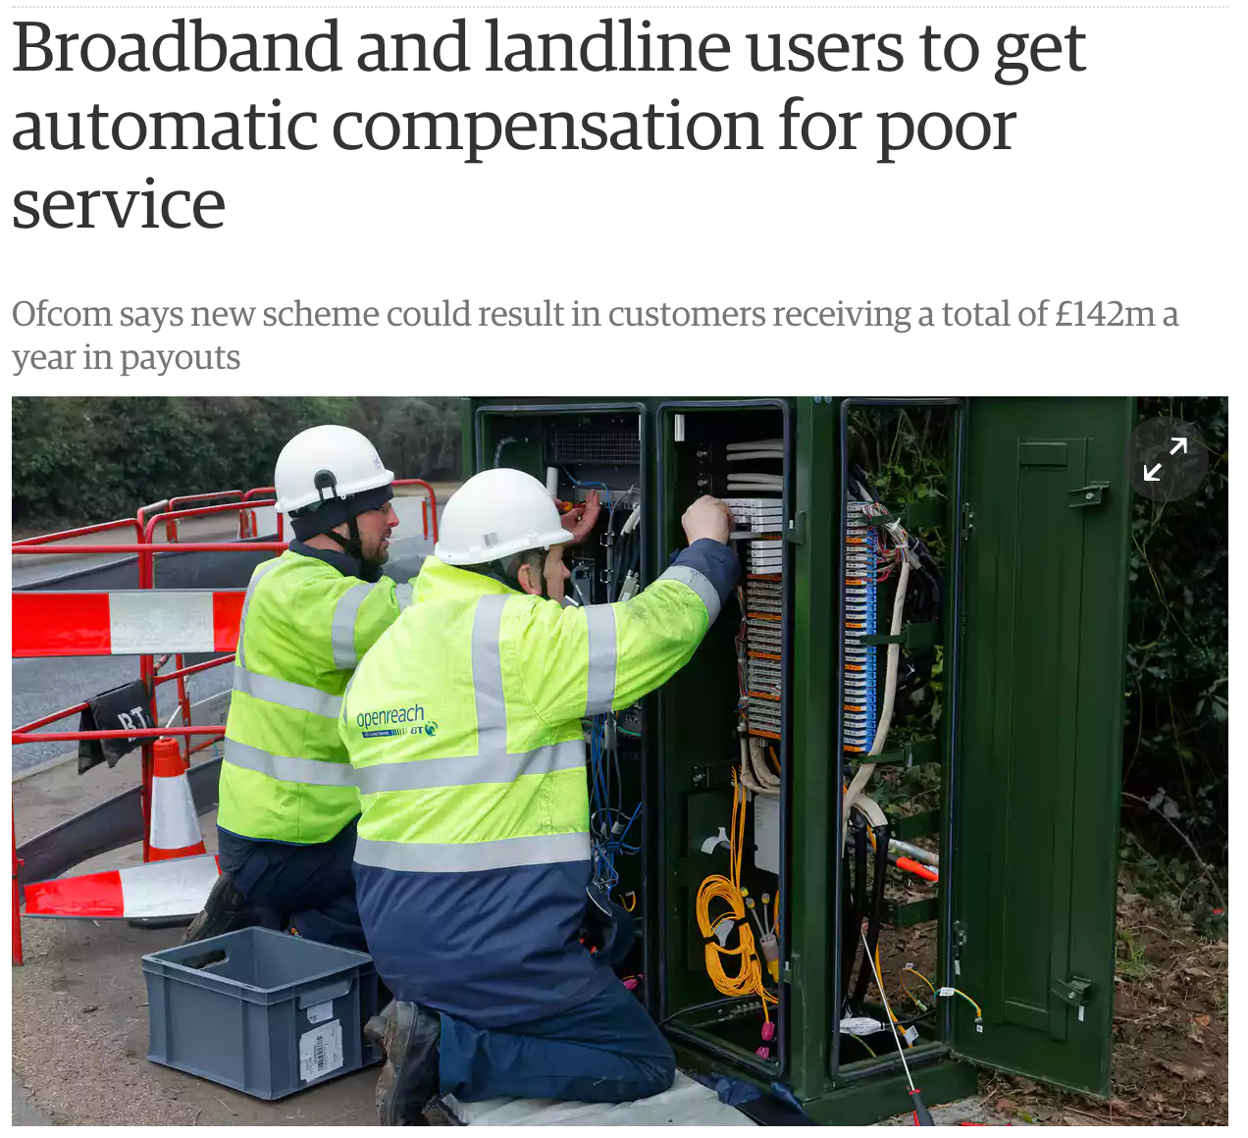
November 10, 2017
Notes:
This is a topic that I’ve been interested in a while now, so it was interesting to see that the Office of Communications in the UK proposed an automatic compensation model for users hit by service outages or extended periods of poor quality of service. For example, they proposed reimbursing subscribers 10 pounds per day after two days of service issues not being resolved.

Slide 5
Broadband reliability – Key questions
Does reliability matter to end users?
How reliable are broadband services?
If not sufficiently reliable, how can we improve them?

Slide 6


Dataset (1/2) – FCC/SamKnows
Deployed ~11k gateways in the US
Use ping, DNS queries and network usage data
Ping and network usage data aggregated per hour
Notes:
In the context of this work, we measure users’ reactions to network conditions that occur “naturally”
Most of the analysis in this presentation is based on data from the public FCC/SamKnows dataset, using data collected from approximately 8,000 gateways in the US.
In our experiments on reliability, we looked at how network usage was affected by poor reliability. That is, if users are unhappy, they use their service less.

Slide 7
Dataset (2/2) - Namehelp
Endhost software for improving CDN replica selection
Installed on over 6,000 clients in 75 countries
Ping, traceroute and DNS queries at 30 second intervals
Only running while host is running
  Biased towards peak hours

Slide 8
Datasets pros/cons
Wide coverage of the US
Detailed subscriber data (speed, tech)
Pings/packet loss aggregated hourly
Can’t analyze outages at finer granularity
(+)
Fine-grain measurement results
Full experimental control
Lower coverage of US
Lacking detailed subscriber info

Slide 9
Impact of reliability – method
Measure users’ reactions to spontaneous network conditions
Use FCC/SamKnows dataset
  Use ping and network usage data
Use network usage as a proxy for Quality of Experience
  Assumption – If unhappy, you use the service less
Notes:
In order to study the importance of broadband reliability, we performed multiple experiments that looked at the relationship between reliability and user behavior.
In the context of this work, we measure users’ reactions to network reliability conditions that occur “naturally”. Using the FCC data, we compared user demand between groups otherwise similar users (e.g., similar service speeds).
Obviously, you expect usage to drop during an after an outage, which we saw, so I’ll just be going over what I thought was one of the most informative experiments.

Slide 10
Frequent high loss & usage
Hypothesis – Frequent periods of high packet loss rates result in lower network demand during periods of normal operation
Natural experiment
  Group users based on fraction of hours with loss ≥ 5%
  Compare across groups, matching confounding factors
Users with 1-10% hours of ≥ 5% loss
Control group | Treatment group | % H holds | P-value
(1%, 10%) | >10% | 68.3 | 3.65x10⁻⁵
(0,5%, 1%) | >10% | 70.0 | 6.95x10⁻⁶
(0.1%, 0.5%) | >10% | 70.8 | 2.87x10⁻⁶
(0%, 0.1%) | >10% | 72.5 | 4.34x10⁻⁷
Increasing difference between control and treatment group’s services
Greater impact
Notes:
Our hypothesis in this experiment was that users that experienced frequent periods of high packet loss, would have lower demand on their network, even during periods of while their service operated normally. To rephrase one more time, we believed subscribers with less reliable connections used them less heavily even when they weren’t having issues.
To perform this experiment, we grouped users based on how frequently they experienced high loss. We then matched otherwise similar users across these groups and compared their demand during peak hours.
Overall, we did find that that this held true, particularly when looking at users of services with very frequent periods of high loss.

Slide 11
Characterizing reliability
More reliable; high loss
rates occur less frequently
Less reliable; high loss
rates occur more frequently
Notes:
One of the issues with quantifying reliability in the context of the Internet is how to precisely define both reliability and a failure.
In this work, we’re talking about reliability in terms of whether or not the network service is available. Other works, including some from my lab, have looked at reliability in terms of consistency of performance.
Next, a failure in a “best effort” system like the Internet is difficult to define. A single lost packet shouldn’t be marked as a failure of the service. So we’ll be looking at the distribution of loss rates observed on each ISP and compare at different loss rate thresholds.
This figure represents the fraction of hours less than each loss rate threshold. Curves that are up and to the left represent more reliable connections. Lower and to the right means that high loss rates occur more frequently.
Five nines = ~5 minutes per year
Four nines = ~1 hour per year
Three nines = ~9 hours per year
Two nines = ~3.5 days per year
One nine = ~1 week

Slide 12
What is a failure?
Notes:
In this example, the ranking of how these ISPs compare changes at a different threshold. In this case, Mediacom performs worse than Insight at the 1% loss rate threshold, but better than Insight at the 10% loss threshold.
Throughout this work, we compare providers across these thresholds because depending on the type application, performance can degrade significantly above these thresholds. Other works have shown that online gaming can be significantly affected at 1% loss. Live video streaming can start to suffer around 5% loss. And by 10% loss, most applications, even simple web browsing, suffer significantly.
Comcast -> Cox -> Insight -> Mediacom at 1%
Comcast -> Cox -> Mediacom -> Insight at 10%

Slide 13
Effect of…
Service provider
Access technology
Service tier
Longitudinal trends
Demographics
ISP’s DNS availability
Notes:
I’ll briefly go over some of the highlights, but in our paper, we look evaluate services across different groupings. We compared across providers, by technology, across “tiers” of service (business vs. residential), demographics in the regions, and study ISP DNS availability.

Slide 14
ISP and reliability
At 1% threshold, one provider with >99% avail.
At 10% threshold, 13/19 providers with >99% availability
Notes:
Looking at the results by provider, if we use the 1% loss rate as the threshold for a failure, then only a single provider is able to meet two nines of availability. At the 10% loss threshold, about 2/3 of the providers are able to reach two nines, though none are able to reach three nines of availability. This corresponds to a total of over 3 days of unavailability annually.

Slide 15
Access technology
Notes:
Across the technologies, the trends were close to what we expected. Fiber services tended to be the most reliable, followed by cable and DSL. Wireless and satellite trailed further behind.

Slide 16

Technology, service tier and reliability
Two providers offering services over two
different access technologies
  CDF service availability
It’s technology over provider
Tier (residential vs. business) has very little effect
Notes:
However, it’s difficult to state definitively that these trends are due solely to the technology being used. It is possible that companies with fiber services happen to be more reliable for other reasons. Luckily, there are a handful of providers in our dataset that offer service over multiple technologies, DSL and fiber. For each provider, customers of fiber services measured higher service reliability.
There were also some providers that also had “business” tier offerings. Though the sample size of these services was somewhat small, we were unable to differentiate them in terms of service availability from residential services.

Slide 17
Longitudinal trends
AT&T
Comcast
Notes:
We also looked at longitudinal trends across the providers. Unfortunately, we did not really see any consistent improvement across the datasets. However, some providers did tend to be noticeably more consistent than others.

Slide 18
Improving reliability
Two ways to improve reliability
  Reduce the probability of a component failure
  Bypass failures by adding redundancy
Improving the technology itself is a long, expensive process
  E.g., upgrading DSL to fiber means laying new cable
Notes:
In reliability engineering, there are two traditional ways to improve the reliability of a system. One is to improve the parts and reduce the probability of component failure. The second is to add redundancy.
Unfortunately, improving the technology is a long expensive process and not something we can easily try.

Slide 19
End-system “multihoming”
Neighbors lending networks as a backup
ISP provided 3/4G backup connections
To get a sense of its potential
  Group users per census block
  Online during the same
  period
Multihomed
(same ISP)
MTBF (hours)
Multihomed
(different ISP)
No multihoming
Notes:
That leaves us with the possibility of adding redundancy. Our idea here is to “multihome” the access link. There are multiple ways this can be done, such as neighbors lending access to their network as a backup. A number of ISPs are also in the mobile market and could potentially provide customers with a 4G backup connection (perhaps limited).
To get a sense of the potential of this approach, we simulated a multihomed connection by grouping users in the same census block. Though two users in the same census block may not be able to feasible share their connections, it does give us an idea of how much improvement we could see from this approach.

Slide 20
End-system multihoming
By multihoming with different ISPs – four 9s availability

Slide 21
Summary and open issues
An empirical demonstration of the impact of broadband reliability on user demand
A characterization of service reliability in the US
And a practical proposal to improve on it
How to capture QoE at scale, diagnose and localize impairments?

Slide 22

Characterizing and Improving the Reliability of Broadband Internet Access
Zachary Bischof
Fabian Bustamante
Nick Feamster

Slide 23
Adjusting window sizes
Use Namehelp data to simulate different window size selection for outages
Changing time window size only minor impact on availability, no impact on relative ranking

Slide 24
Characterizing reliability
Metrics of reliability: Mean Time Between Failure (MTBF), Down Time, Availability
Defining a failure for a best-effort service
Cox vs. Insight at 1% packet loss: Avg ADT ~0.6% difference (2hr)
Cox vs. Insight at 10% packet loss: Avg ADT ~37% difference (34hrs)
Avg Annual Down Time – Failures at 1%
Avg Annual Down Time – Failures at 10%
Use three thresholds: 1%, 5% and 10%
Notes:
So not only do users complain about reliability, but we now know that it can affect user behavior. Despite the importance of reliability, it is typically overlooked by studies on broadband access.
As part of this work, we developed an approach to characterizing broadband service reliability using data from studies like the FCC’s Measuring broadband America. We used traditional metrics like MTBF, downtime, and availability.
However, how to define a failure in a best effort service like the Internet is somewhat unclear. A single packet loss could be considered a failure, but is unlikely to be noticed by the user. So instead, we look for a significant number of dropped packets and use multiple thresholds to capture different severities of failures.
Previous works have found that ~1% loss was manageable for many applications. Was problematic for some real-time apps like gaming, but video chatting, though possibly degraded was manageable. Around 4-6% loss, video chat starts to suffer. And around 10% loss, throughput rates are severely degraded and most applications become nearly unusable.
~30 seconds, 3 minutes, and 6 minutes.

Slide 25

Access technology and reliability
Mean Time Between Failures in hours
Fiber
Wireless
Satellite
Cable
DSL
Fiber dominates,
Cable and DSL are next

Slide 26
Longitudinal trends
Viasat
Notes:
One exception was Viasat, a satellite service provider. There was an improvement, but this was mostly due to multiple outages over a longer period of time.

Slide 27
Broader context – demographics
Combine FCC MBA dataset with US Census Bureau, explore:
  Urbanization level: urbanized areas, urban clusters and rural areas
  Median income
Found weak/moderate correlations
  With urbanization levels – r = - 0.397
  With median income – r = - 0.569
Urbanization
Lower urbanization, worse reliability
Loss rate
GPS per capita
Lower median income, worse reliability
Loss rate
Notes:
We also looked for trends in the relationship between service reliability and the demographics of a region. Using census data, we looked for relationships between reliability and urbanization levels, and reliability and median income. In both cases, we found some negative correlation. This was largely due to the fact that less urbanized regions and regions with lower median incomes were more highly reliant on less reliable technologies.

Slide 28
Broader context – DNS reliability
If all queries fail (10/10), a server is marked as unavailable
To users, DNS and network failures are indistinguishable
  But their reliability is not always correlated

Slide 29
Broader context – DNS reliability
Top 6 ISPs by connection and DNS availability
ISP | Availability @ 5%
Verizon Fiber | 99.67
Cablevision | 99.53
Frontier Fiber | 99.47
Comcast | 99.45
Charter | 99.29
Bright House | 99.28
ISP | DNS
Insight | 99.97
Windstream | 99.90
Qwest | 99.90
Hughes | 99.90
Frontier Fiber | 99.90
Cox | 99.90
Connection reliability alone is not enough
Only one provider in common
Notes:
Previous work has shown that DNS plays a significant role in determining application level performance [40 , 54 ] and thus users’ experience.
Additionally, for most broadband users, the effect of a DNS outage is identical to that of a faulty connection.

Slide 30
Where do reliability issues occur?
What is the cause of broadband reliability issues?
  End host, ISP, or destination?
76% of issues are connecting to or going through the provider’s network
Notes:
Again, this analysis was done using measurement from our namehelp platform rather than

